Slide 1
ML Study Jams
Session 2
Sarthak Harne

Slide 2
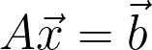
Let’s talk about Projections!
Why do we talk about projections!
As always, the root of all our problems is:
As we all know, this won’t always have a solution. That happens, when our, matrix is tall i.e. the number of rows (m) > the number of columns (n)
But what’s the problem with that?

Slide 3
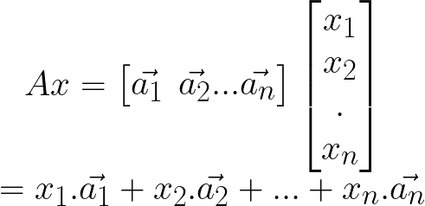
Matrix-Vector Multiplication
Column Interpretation
We can we a matrix A (mxn) as:
By writing A like this, we can interpret Matrix-Vector multiplication as:

Slide 4
The Column Space of A
This is why Ax = b is not always solvable for tall matrices!
If b does not lie in the Column Space of A, then Ax = n has no solution!
Notice, that Ax is just a linear combinations of all the column vectors! So, if b cannot be expressed as a linear combination of all the column vectors, Ax = b will have no solution!

Slide 5
Let’s take an example!
We encourage you to try using the link below and play around!
We plotted an example of GeoGebra 3D Graphing Calculator: Link

Slide 6
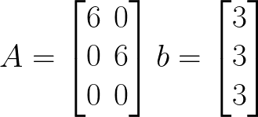
Let us write it down
From our example, we have:
What is the Column Space of A?

Slide 7
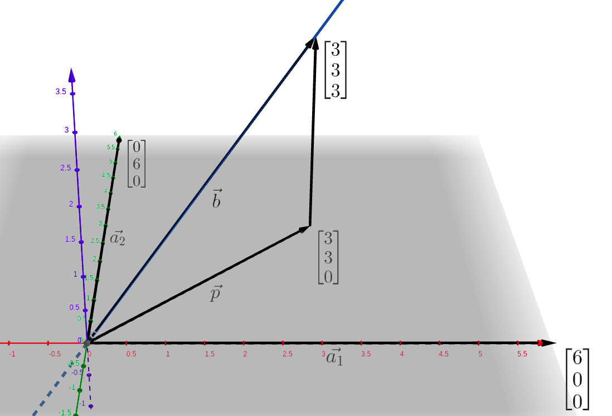
Okay, so we do not have a direct solution
But,as engineers,we will learn to live with an approximation
All we need to do is to find the point nearest to b on our Column Space! What is the condition for a point p to be the point closest to b?

Slide 8
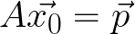
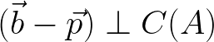
Perpendicularity!
Let us assume that we have x₀ and p, such that:
We also know that:

Slide 9
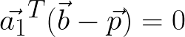
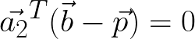
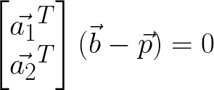
Solving a little further…
As a₁ and a₂ are in C(A), we can say:
Or…

Slide 10
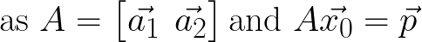
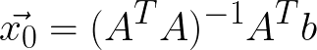
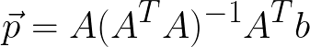
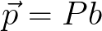
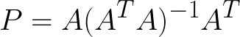
The Final Stretch!
After some substitutions, we have:
Solving for x₀ and p we get:
aka Projection Matrix!

Slide 11
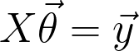
Okay, but how does that matter?
Where else did you see a tall matrix and an approximation?
You can call it:
I like to call it:

Slide 12
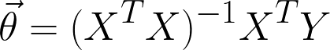
The solution for this was…
Aka the Closed Form Solution!

Slide 13
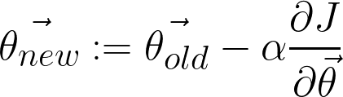
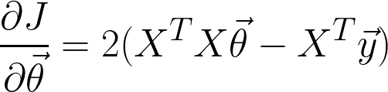
But there was another solution!
The Gradient Descent Solution:
The Gradient of the Loss Function:

Slide 14
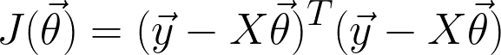
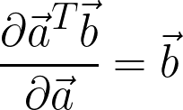
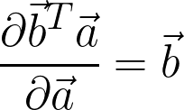
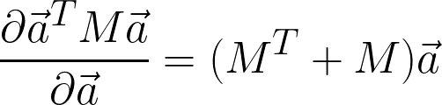
Optionally, you could try finding these
You can easily find the value of the Gradient
We have the loss function:
Try to derive the equation for gradient using the following. Remember, X is a N*d matrix, 𝛳 is a d-column-vector and y is a N-column-vector.
a and b are vectors, M is a square matrix

Slide 15

Time for a Demo!
Scan the QR Code or go to the website on your laptop
https://bit.ly/3SKEP3N

Slide 16
Links to the Code
Session 1: https://github.com/sarthakharne/ML-Study-Jams-Session-1
Session 2: https://github.com/sarthakharne/ML-Study-Jams-Session-2-Demo

Slide 17
Thanks for attending!
GDSC IIIT Bangalore

